Slide 1
Digital Service Providers Australia New Zealand
Consistent Data Mapping Focus Group
- Meeting 2

Slide 2
Acknowledgement
of Country
Notes:
Original slides - https://docs.google.com/presentation/d/1IwILHPNrm_sJf82dHpXngVedG6vHsqwDqPHzRWL4yVQ/edit?usp=sharing

Slide 3
Today’s Agenda
Acknowledgement of Country
Introduction (5 mins)
Introduction of Attendees (20 mins)
Review of the sample invoices / issues (30 mins)
Meeting close (5 mins)

Slide 4
Supplier
Buyer
A-NZ Industry Practice Statements
A-NZ Peppol Ready Provider
A-NZ Peppol Guidance Notes
A-NZ Peppol BIS3.0 Specifications
Peppol BIS 3.0 Specifications
Peppol Code Lists
European Norm (EN16931)
ISO or UNECE Code Lists (and others)
ISO/OASIS Universal Business Language Version 2.1 (UBL 2.1)
A-NZ Industry Practice Statements
A-NZ Peppol Ready Provider

Slide 5
Consistent Data Mapping Issues
Issue 1. – Base Quantity is greater that invoiced Quantity
Issue 2. – Incorrect approach to GST
Issue 3. – Attachment File Name
Issue 4. – Various data elements:
  Issue 4.1. – Organisational specific customer identifiers
  Issue 4.2. – Non-Financial Delivery Information
  Issue 4.3. – Freight/delivery charges
  Issue 4.4. – Calculated Quantities
  Issue 4.5. – Asset/equipment identifiers
  Issue 4.6. – Additional data supporting payment of this invoice (e.g. Timesheets, usage)
  Issue 4.7. – Additional data influencing customer purchasing decisions (e.g. trend data)

Slide 6
Issue 1. – Base Quantity is greater that invoiced Quantity
The price is specified in blocks/units of 10, but the invoice is only for 1.
Has caused real issues in C4 processing, because of an (incorrect) assumption this cannot happen. Noting that some
Software cannot present this so it will be changed to a Qty of 1 for the price, anyway.
A real life example might be pricing by dozen eggs, but only a single egg is purchased.
<cac:InvoiceLine>
<cbc:ID>111</cbc:ID>
<cbc:InvoicedQuantity unitCode="EA">1</cbc:InvoicedQuantity>
<cbc:LineExtensionAmount currencyID="NZD">0.17</cbc:LineExtensionAmount>
<cac:Item>
<cbc:Description>250g sardines in brine</cbc:Description>
<cbc:Name>Sardines</cbc:Name>
<cac:ClassifiedTaxCategory>
<cbc:ID>S</cbc:ID>
<cbc:Percent>15</cbc:Percent>
<cac:TaxScheme>
<cbc:ID>GST</cbc:ID>
</cac:TaxScheme>
</cac:ClassifiedTaxCategory>
</cac:Item>
<cac:Price>
<cbc:PriceAmount currencyID="NZD">1.7</cbc:PriceAmount>
<cbc:BaseQuantity unitCode="EA">10</cbc:BaseQuantity>
</cac:Price>
</cac:InvoiceLine>

Slide 7
Issue 2. – Incorrect approach to GST
Real invoice that was received, where the GST has been calculated from other elements rather than specified as 10.
It makes no difference to the calculation of GST amount (it will be $0.11 in either case), but this could cause problems at C4 and is not correct.
Similarly, a Percent of 9.99999999999 is not correct.
<cac:InvoiceLine>
<cbc:ID>null</cbc:ID>
<cbc:InvoicedQuantity unitCode="H87">1</cbc:InvoicedQuantity>
<cbc:LineExtensionAmount currencyID=“AUD">1.14</cbc:LineExtensionAmount>
<cac:Item>
<cbc:Description>0</cbc:Description>
<cbc:Name>62148-</cbc:Name>
<cac:SellersItemIdentification>
<cbc:ID>62148-</cbc:ID>
</cac:SellersItemIdentification>
<cac:ClassifiedTaxCategory>
<cbc:ID>S</cbc:ID>
<cbc:Percent>9.65</cbc:Percent>
<cac:TaxScheme>
<cbc:ID>GST</cbc:ID>
</cac:TaxScheme>
</cac:ClassifiedTaxCategory>
</cac:Item>
<cac:Price>
<cbc:PriceAmount currencyID=“AUD">1.14</cbc:PriceAmount>
</cac:Price>
</cac:InvoiceLine>

Slide 8
Issue 3. – Attachment File Name
Having a filename as the ID element is not obviously incorrect.
However, it is likely to cause issues if C4 expects the file name to be in this element.
The specification describes the ID element as:
    Invoiced object identifier, Supporting document reference
    An identifier for an object on which the invoice is based, given by the Seller, or the identifier for the supporting document.
    Example value: AB23456
There is also an optional schemeID with associated codelist (UN/CEFACT 1153).
The filename & mimeType are both mandatory and should be used for identifying the attachment type, the same as would be done for email attachments.
<cac:AdditionalDocumentReference>
<cbc:ID>Supporting Document.pdf</cbc:ID>
<cac:Attachment>
<cbc:EmbeddedDocumentBinaryObject filename="Supporting
Document.pdf" mimecode="application/pdf"> ....
</cbc:EmbeddedDocumentBinaryObject>
</cac:Attachment>
</cac:AdditionalDocumentReference>

Slide 9

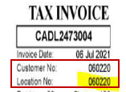


  Issue 4.1. – Organisational specific customer identifiers
Questions related to Account number/Membership number/Location number:
  Is this required if PO is provided?
  Is this required / desirable if PO is not provided?
  What’s the best field to map? what’s the alternative?

Slide 10

  Issue 4.2. – Non-Financial Delivery Information
Questions related to Non-Financial Delivery details, e.g. Carrier name/contact, tracking number:
  Is this required by C4?
  Where should this information be mapped?

Slide 11
  Issue 4.3. – Freight/delivery charges
What are the potential methods to include freight and delivery charges?
  Document level (using AllowanceCharge)
  Document level (as a separate line item)
  Line level (using InvoiceLine/AllowanceCharge)

Slide 12
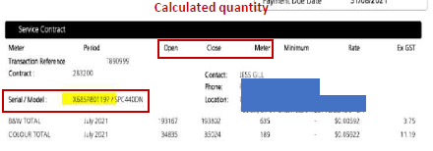

  Issue 4.4. – Calculated Quantities
How do we include calculated quantity information?

Slide 13
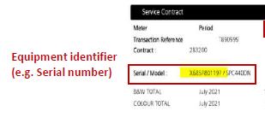

  Issue 4.5. – Asset/equipment identifiers
Where do we put serial and asset numbers for equipment?

Slide 14
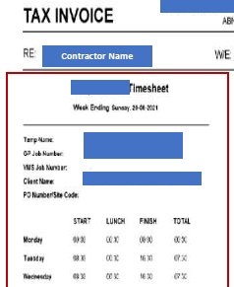
  Issue 4.6. – Additional data supporting payment of this invoice (e.g. Timesheets, usage)
Where do we put timesheet data?

Slide 15
  Issue 4.7. – Additional data influencing customer purchasing decisions (e.g. trend data)
Where do we put other data not directly related to the invoice period?

