Slide 1
Digital Service Providers Australia New Zealand
Attachments Focus Group
Meeting 4, 17 October 2022

Slide 2
Today’s Agenda
Welcome attendees and acknowledgement of traditional owners
Service provider survey results (solutions’ capability / limitations for attachment)
What the WG has discussed and agreed upon so far
Group discussion (continue)
  Obligation / best practice for C3: virus scan
  Obligation / best practice for C3: if attachment size/format is beyond C4 solution capability
Potential opportunities for improvement: attachment metadata supported by UBL
Next steps / wrap up

Slide 3
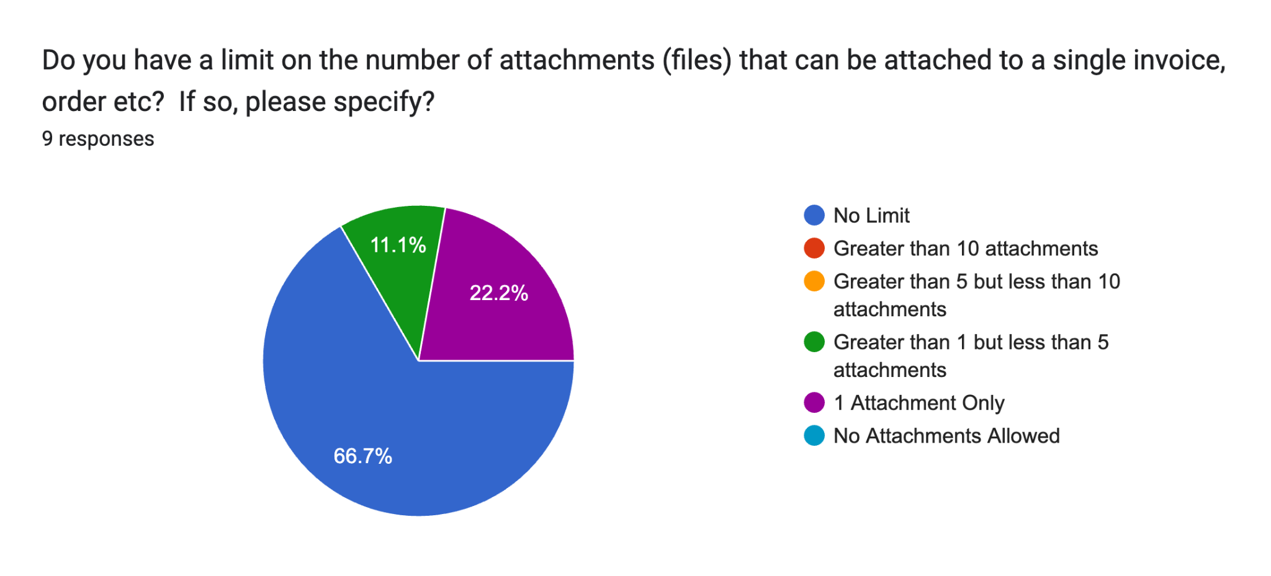
Solution capabilities
Majority (89% supported attachments to invoices)
Many supported attachments for other transactions (67%) with the remainder either not supporting or not applicable as they only support invoices
Common limits on single:
  No limit
  5MB
Common limits on total:
  No limit
  100MB
Common supported attachment file types: no restrictions, PDF, PNG, JPEG, CSV, spreadsheet .xlsx, spreadsheet .ods
Do you have a limit on the number of attachments (files) that can be attached to a single invoice, order etc? If so, please specify.
(9 responses)

Slide 4
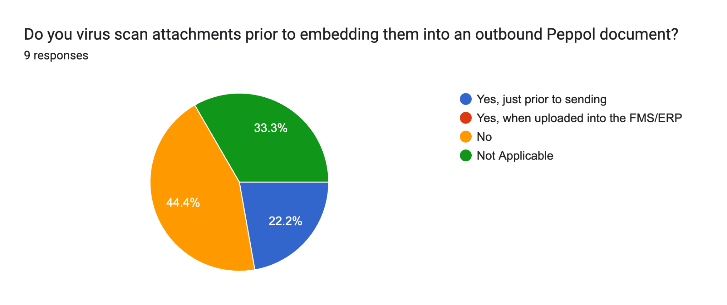
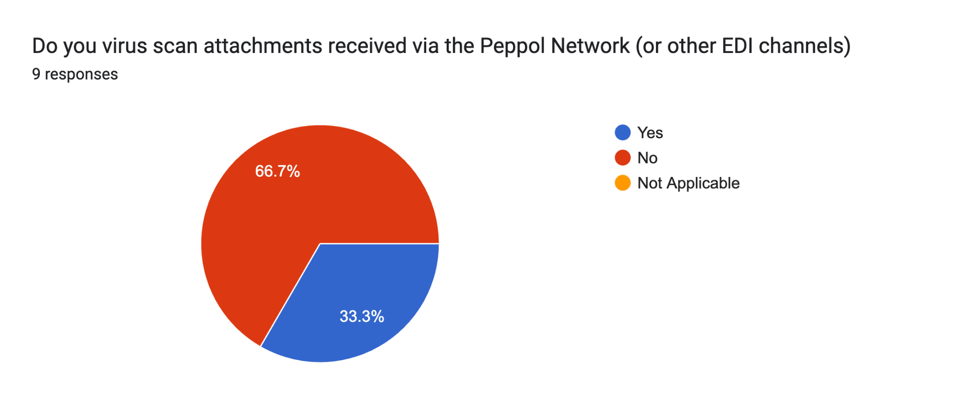
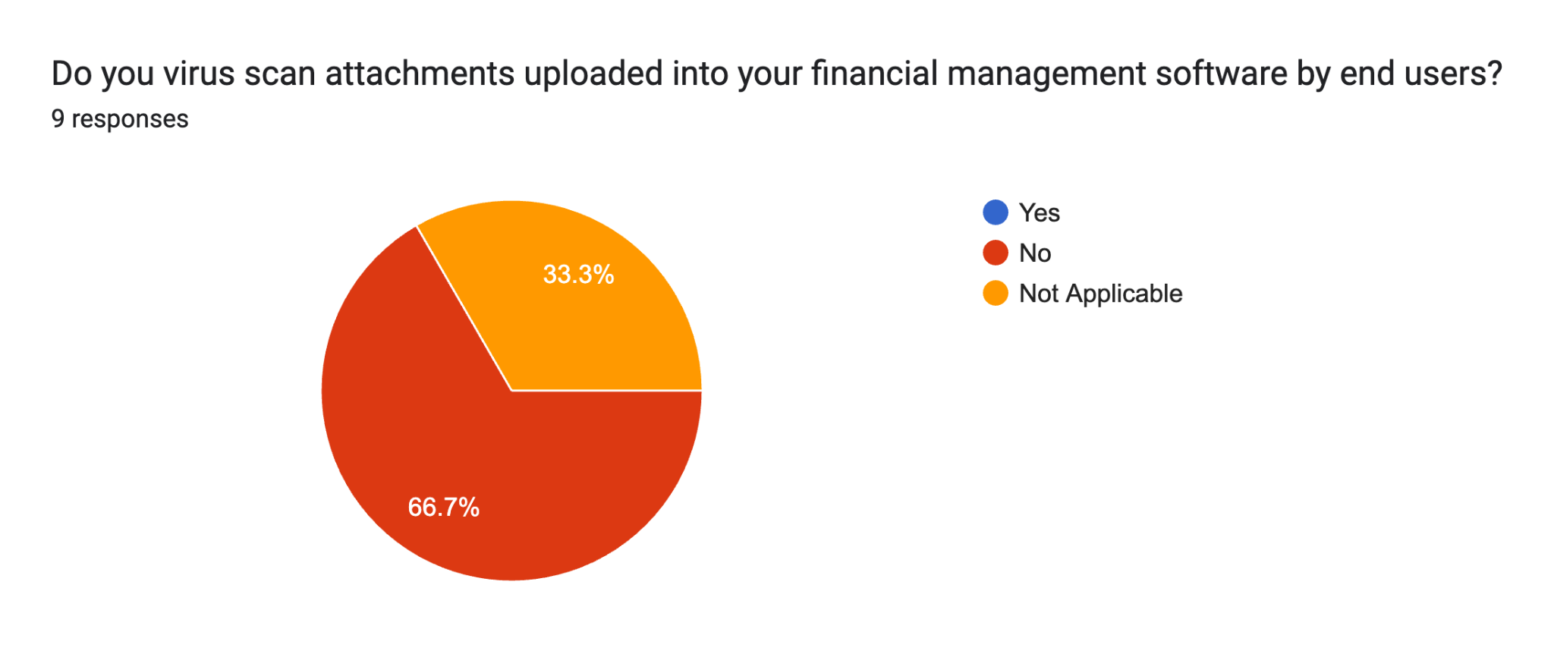
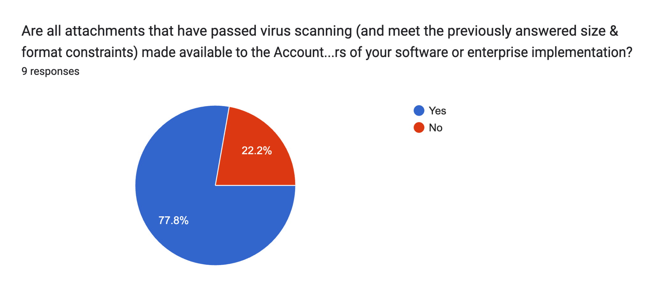
Virus Scanning (9 responses)
Do you virus scan attachments prior to embedding them into an outbound Peppol document?
Do you virus scan attachments received via the Peppol Network (or other EDI channels)
Are all attachments that have passed virus scanning (and meet the previously answered size & format constraints) made available to the Accounts Payable End Users of your software or enterprise implementation?
Do you virus scan attachments uploaded into your financial management software by end users?

Slide 5
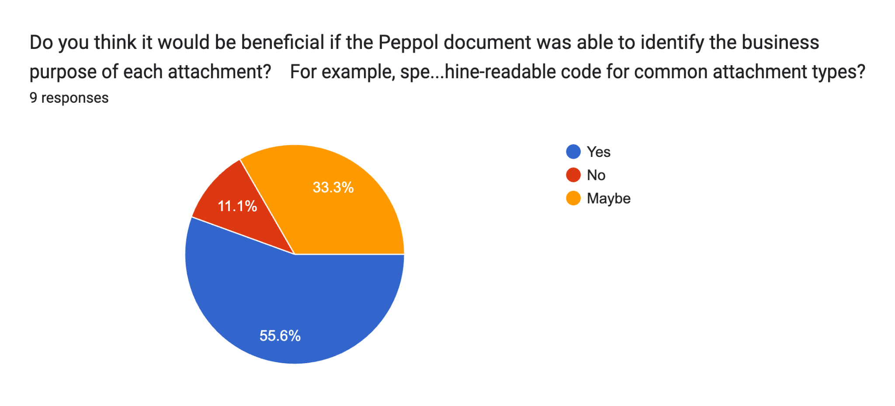
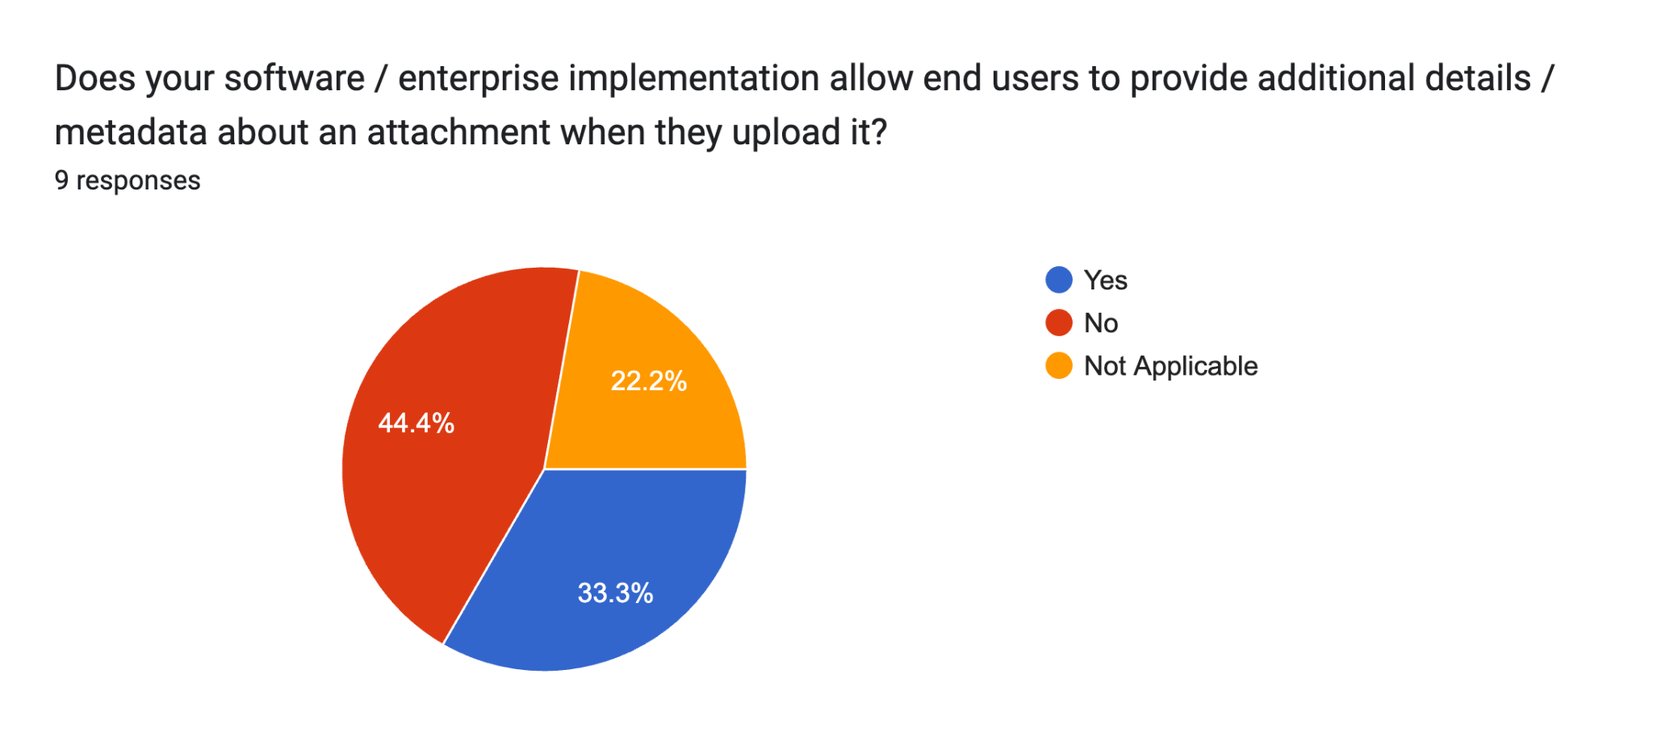
Automation & Processing (9 responses)
Support for identifying business purpose of attachments
Do you think it would be beneficial if the Peppol document was able to identify the business purpose of each attachment? For example, specifying a machine-readable code for common attachment types?
Does your software / enterprise implementation allow end users to provide additional details / metadata about an attachment when they upload it?

Slide 6
Re-cap the context and issue statement for Attachment
Context and Issue Statement
As agreed at the Consistent Data Mapping focus group, a separate focus group was required to develop guidance to support end users in the use of attachments for Peppol Invoice and Credit Note transactions.
There are varied levels of support of attachments and guidance is required to promote consistent support for sending, receiving and managing attachments (e.g. accessibility, storage), which will strengthen data quality and richness, and maximise positive client experience. The following topics were raised:
Data mapping – interpretation and use of available UBL fields, and how to indicate a rendered invoice attachment vs support information
Attachment formats that are supported by Peppol – i.e. understand the code list
Solution capabilities
End User consideration: filling and virus scanning
Use cases where attachments are required (e.g. utilities, labour hire)
Relevant materials for this working group is can be found here.

Slide 7
What has been discussed and agreed on so far
Purpose of outcome document:
Support the understanding of use cases for attachments
Understand Peppol functionality for supporting attachments
Provide mapping guidance on existing UBL fields for attachment
Summarise findings of various ranges of solutions capabilities in the A-NZ communities
Summarise findings and considerations to support end users make informed decisions
What’s supported in Peppol Invoice/credit note
Format/Type: Attachment format types supported by the Peppol code list include text/CSV, PDF, image (i.e. PNG and JPEG), spreadsheet (XLSX, OASIS open document).
Quantity per transaction: Multiple attachments are allowed per invoice. The Peppol Framework does not specify a limit to quantity of attachments per invoice, however, overall size limit exists.
Size: Peppol SLA requirements advises a message size of 100MB (including XML and attachments) for post-award documents
Data mapping guidance
See slide 9
Attachment use cases and rendered xml data:
Chapter 6.2.10 of Peppol BIS Billing states the attachment functionality is not intended to include a copy of the invoice in an image format.
The group acknowledges that common practice and is sometimes required to convey additional information. Some receivers rely on, and welcome this practice, whereas some BMS will generate a rendered image.
Virus Scan (see next slide)

Slide 8
What has been discussed and agreed on so far
Virus Scan
C2 MUST virus scan attachments to ensure no harmful transmission of viruses with other party’s computer systems.
  Supported by Section 10.3 & 17.1 of the Peppol Service Provider Agreement:
    10.3. The Parties shall use measures and procedures in accordance with accepted best industry practices to protect their own data systems used to perform this Agreement against illicit use, malicious code, viruses, computer intrusions, infringements and illegal tampering of data and other comparable actions by third parties. The Parties agree to use accepted best industry practices and efforts to avoid the transmission of any viruses, time bombs, worms or similar items or any computer programming routines that may interfere with other Parties computer systems.
    17.1. The Parties shall implement appropriate technical and organizational measures to protect the integrity and continuous operation of the Peppol Interoperability Framework and all data exchanged across the Peppol Network against accidental or unlawful destruction or accidental loss, alteration, unauthorized disclosure or access, and against all other forms of processing contrary to this Agreement and applicable law. [etc.]
  This working group was also in broad agreement with this requirement.
C3s MUST virus scan attachments before passing on the message to its clients
  C3s should virus scan before passing on the message to its clients (Initial position of this group following discussion)
  Peppol Operating Office has confirmed the intent was MUST, we will seek to confirm through the Agreements, Policies and Procedures CMB (APPCMB)

Slide 9
Data mapping guidance
Data fields should be utilised according to their semantic definitions, as per the A-NZ Peppol Invoice Specification.
There are three pieces of xml data that must be provided when sending attachments:
Attachment ID: This should be the document identifier (similar to a PO having a PO number) of the attachment if applicable.
File name attribute: This should be the title / name of the attached document, e.g. Supporting Document.pdf.
Mime code attribute: This field is to specify the format of an attachment. The appropriate code from the Peppol code list must be used.
Note: document type extension (e.g. .pdf) should be included to simplify storage and access by the receiver. However, not all solutions support this and therefore it is recommended that C4 rely on the mime code attribute to determine the format of attachments.
Identifying rendered copies and supporting documentation: Where multiple attachments exist, the sender should differentiate between a rendered invoice copy, and other supporting information. Some sending solutions, by default, will include a rendered version (e.g., PDF) of the eInvoice, along with additional information (e.g., to meet regulatory requirements, support, marketing messages etc.). The group recommends that Peppol data fields for attachments are populated with the following options, to better identify the purpose of the attachment:
Peppol data fields | Rendered eInvoice options | Supporting documents options
Attachment ID (cac:Attachment/cbc:ID) | Invoice number, e.g. INV123 | This should be the identifier of the supporting document, if applicable, e.g. timesheet_wk18. If the attached document does not have an identifier, it is recommended to re-use the value of @filename.
File name (cac:Attachment/cbc:Embedded DocumentBinaryObject/@filename) | Suggested default value of “Rendered_Invoice_INV123.pdf”, acknowledging that not all implementations will include the file type extension (e.g., pdf) in file name. | This is the name of the attached file, e.g. Supporting_document.jpeg.
Mime code (cac:Attachment/cbc:Embedded DocumentBinaryObject/@mimeCode) | Must use one of the code from the Peppol code list, e.g. application/pdf”. | Must use one of the code from the Peppol code list, e.g. image/jpeg”.

Slide 10
Attachment – other metadata supported by UBL
The foundational standard that underpins the Peppol BIS is known as Universal Business Language (or UBL for short).
UBL contains additional metadata for the Attachment and DocumentReference concepts.
Peppol Pre-Award and Post-Award use different elements and attributes for the Attachment and DocumentReference concepts.
The current Peppol BIS supports core attachment requirements.
This topic looks at potential improvements that could future proof Peppol and provide increased opportunity for automation

Slide 11
Attachment – other metadata supported by UBL
UBL Name | UBL Definition | Used in Peppol?
Attachment | A class to describe an attached document. An attachment can refer to an external document or be included with the document being exchanged. | YES
EmbeddedDocumentBinaryObject | A binary large object containing an attached document. | YES
mimeCode | The mime type of the binary object. | YES
characterSetCode | The character set of the binary object if the mime type is text. | -
encodingCode | Specifies the decoding algorithm of the binary object. | -
filename | The filename of the binary object. | YES
format | The format of the binary content. | -
uri | The Uniform Resource Identifier that identifies where the binary object is located. | -
ExternalReference | A reference to an attached document that is external to the document(s) being exchanged | YES
URI | The Uniform Resource Identifier (URI) that identifies the external object as an Internet resource | YES
DocumentHash | A hash value for the externally stored object | YES
HashAlgorithmMethod | A hash algorithm used to calculate the hash value of the externally stored object | YES
ExpiryDate | The date on which availability of the resource can no longer be relied upon | -
ExpiryTime | The time after which availability of the resource can no longer be relied upon | -
MimeCode | A code signifying the mime type of the external object | YES
FormatCode | A code signifying the format of the external object | -
EncodingCode | A code signifying the encoding/decoding algorithm used with the external object | -
characterSetCode | A code signifying the character set of an external document | -
FileName | The file name of the external object | YES
Description | Text describing the external object | YES

Slide 12
Attachment – Peppol Post-Award Attachments
 |  | Post Award
Field Name | UBL Cardinality | Invoice | Credit Note | Order | Order Response | Order Agreement | Catalogue | Catalogue Response | Despatch Advice | Punch out | MLR | Invoice Response
Parent Element |  | ADR | ADR | ADR | - | ADR | ISDR | - | - | ISDR | - | -
Attachment |  | Y | Y | Y | X | Y | Y | X | X | Y | X | X
EmbeddedDocumentBinaryObject | 0..1 | 0..1 | 0..1 | 0..1 | X | 0..1 | 0..1 | X | X | 0..1 | X | X
mimeCode | M | M | M | M |  | M | M |  |  | M
characterSetCode | O | X | X | X |  | X | X |  |  | X
encodingCode | O | X | X | X |  | X | X |  |  | X
filename | O | M | M | M |  | M | M |  |  | M
format | O | X | X | X |  | X | X |  |  | X
uri | O | X | X | X |  | X | X |  |  | X
ExternalReference | 0..1 | 0..1 | 0..1 | 0..1 | X | 0..1 | 0..1 | X | X | 0..1 | X | X
URI | 0..1 | 1..1 | 1..1 | 1..1 |  | 1..1 | 1..1 |  |  | 1..1
DocumentHash | 0..1 | X | X | X |  | X | X |  |  | X
HashAlgorithmMethod | 0..1 | X | X | X |  | X | X |  |  | X
ExpiryDate | 0..1 | X | X | X |  | X | X |  |  | X
ExpiryTime | 0..1 | X | X | X |  | X | X |  |  | X
MimeCode | 0..1 | X | X | X |  | X | X |  |  | X
FormatCode | 0..1 | X | X | X |  | X | X |  |  | X
EncodingCode | 0..1 | X | X | X |  | X | X |  |  | X
characterSetCode | 0..1 | X | X | X |  | X | X |  |  | X
FileName | 0..1 | X | X | X |  | X | X |  |  | X
Description | 0..n | X | X | X |  | X | X |  |  | X

Slide 13
Attachment – Peppol Pre-Award Attachments
 |  | Pre-Award
Field Name | UBL Cardinality | EOI Request | EOI Response | Tender Status Request | Call for Tenders | Tender Receipt | Tendering Question | Tendering Answers | Tender Clarification Request | Tender Clarification [Response] | Search Notice Request | Search Notice Response | Tender Withdrawl | Tender Withdrawl Notification | Publish Notice | Notice Publication Response | Awarding Notification
Parent Element |  | - | - | - | ADR | DocRef | ADR | ADR | ADR | ADR | - | - | TDR | TDR | - | - | CDR
Attachment |  | X | X | X | Y | Y | Y (1..n) | Y (1..n) | Y (1..n) | Y (1..n) | X | X | Y (1..1) | Y (1..1) | X | X | Y (0..1)
EmbeddedDocumentBinaryObject | 0..1 | X | X | X | X | X | X | X | X | X | X | X | X | X | X | X | X
ExternalReference | 0..1 | X | X | X | X | 1..1 | 1..1 | 1..1 | 1..1 | 1..1 | X | X | 1..1 | 1..1 | X | X | 1..1
URI | 0..1 |  |  |  | 0..1 |  |  |  |  |  |  |  |  |  |  |  | 1..1
DocumentHash | 0..1 |  |  |  |  | 0..1 |  |  |  |  |  |  | 1..1 | 1..1
HashAlgorithmMethod | 0..1 |  |  |  |  | 0..1 |  |  |  |  |  |  | 0..1 | 0..1
ExpiryDate | 0..1
ExpiryTime | 0..1
MimeCode | 0..1 |  |  |  | 0..1 |  | 0..1 | 0..1 | 0..1 | 0..1 |  |  |  |  |  |  | 1..1
FormatCode | 0..1
EncodingCode | 0..1
characterSetCode | 0..1
FileName | 0..1 |  |  |  | 0..1 |  | 0..1 | 0..1 | 0..1 | 0..1 |  |  |  |  |  |  | 1..1
Description | 0..n |  |  |  |  |  | 1..1 | 1..1 | 1..1 | 1..1

Slide 14
Attachment – other metadata supported by UBL
So what does this all mean?
We could enhance the Post-Award Specifications (by raising a Peppol RFC):
  Improve the use of ExternalReference to better support automation and integrity checking.
  Suggest the following:
    Inclusion of MimeCode
    Inclusion of DocumentHash
    Inclusion of HashAlgorithmMethod
Is there value in supporting expiry date / time?

Slide 15
DocumentReference – other metadata supported by UBL
This is concept is used in multiple places throughout the BIS:
  AdditionalDocumentReference
  ItemSpecificationDocumentReference
  TenderDocumentReference
  ContractDocumentReference
  DepatchDocumentReference

Slide 16
DocumentReference – other metadata supported by UBL
Available child elements:
Parent Element | Description | Type | Cardinality
AdditionalDocumentReference | Varies depending on the specific instance | - | -
ID | An identifier for the referenced document | Identifier | 1..1
Copy Indicator | An indicator that the referenced document is a copy (true) or the original (false | Indicator | 0..1
UUID | A universally unique identifier for this document reference | Identifier | 0..1
IssueDate | The date, assigned by the sender of the referenced document, on which the document was issued | Date | 0..1
IssueTime | The time, assigned by the sender of the referenced document, at which the document was issued | Time | 0..1
DocumentTypeCode | The type of document being referenced, expressed as a code | Code | 0..1
DocumentType | The type of document being referenced, expressed as text | Text | 0..1
Xpath | A reference to another place in the same XML document instance in which DocumentReference appears | Text | 0..n
LanguageID | An identifier for the language used in the referenced document | Identifier | 0..1
LocaleCode | A code signifying the locale in which the language in the referenced document is used | Code | 0..1
VersionID | An identifier for the current version of the referenced document | Identifier | 0..1
DocumentStatusCode | A code signifying the status of the reference document with respect to its original state | Code | 0..1
DocumentDescription | Text describing the referenced document | Text | 0..n
Attachment | The referenced document as an attachment to the document from which it is referenced | Attachment | 0..1
ValidityPeriod | The period for which this document reference is valid | Period | 0..1
IssuerParty | The party who issued the referenced document | Party | 0..1
ResultOfVerification | The result of an attempt to verify a signature associated with the referenced document | ResultOfVerification | 0..1

Slide 17
DocumentReference – other metadata supported by UBL
In many places the concept is restricted to only providing the ID of the related document.
Where the Attachment concept is included (e.g. a document is embedded or referenced by URI), the BIS uses different child elements and attributes.
  Inconsistent use of:
    DocumentTypeCode (code – from various code lists) and
    DocumentType (free text value)
    IssueDate
We could enhance the Specifications (by raising a Peppol RFC):
  Support DocumentTypeCode in all BIS documents
  Remove 130 restriction for the BIS3 Invoice/CreditNote and allow a broader, but Peppol managed sub-set of the UNCL1001 List.

Slide 18
Discussion to be continued
C3’s obligation to virus scan – currently seeking further confirmation from Peppol for C3’s obligation for virus scanning.
C1 and C4 participants are highly recommended to take all efforts to protect themselves and their trading partners against viruses.
Recommended practice if a received Peppol message contains attachments that are beyond C4 solution capability.

