Slide 1
What is Peppol?
Webinar - 16 August 2022

Slide 2
Acknowledgement
of Country
Notes:
Original slides - https://docs.google.com/presentation/d/1IwILHPNrm_sJf82dHpXngVedG6vHsqwDqPHzRWL4yVQ/edit?usp=sharing

Slide 3
Webinar Agenda
Introductions
Brief history of Peppol
Peppol basics
What’s happening across the world
How you can get involved in Australia and New Zealand

Slide 4
Introductions

Slide 5











eInvoicing Members

Slide 6
History of Peppol
Peppol began in 2008 as a large-scale pilot financed by the European Commission and Consortium members.
In 2012, the Peppol project was finalised, and its services and responsibilities were taken over by OpenPeppol, a non-profit international association established under Belgian law.
OpenPeppol is responsible for the development and maintenance of the Peppol specifications, building blocks and its services and implementation
Notes:
The goal of the project was to enable frictionless trade between public and private sector bodies – and, ultimately, to increase efficiencies while promoting healthy competition.
OpenPeppol consists of both public and private sector members and is responsible for the development, implementation, and maintenance of the Peppol specifications.

Slide 7

What is Peppol - from OpenPeppol

Slide 8
OpenPeppol on a Page
OpenPeppol Members
General Assembly
Operating Office
Secretary General
Election Committee
Agreements, Policies and Procedures CMB
Managing Committee
Coordinating Committee
CMB
Peppol Network
End Users
CMB
Post Award
Service Providers
Domain Communities
Stakeholder Communities
CMB
Pre Award
Peppol Authorities
Continuous Transaction Controls
Notes:
The governance process is democratic and fully transparent.
Our member organisations set the agenda, elect representatives to lead the Managing Committee (responsible for strategic development) and the Coordinating Committee (responsible for technical development) and appoint volunteers from member organisations to contribute to the continuous improvement of OpenPeppol and the Peppol network and specifications.
The day-to-day business of OpenPeppol is supported by a small Operating Office, acting under the direction of the elected Secretary General.

Slide 9
Peppol Basics

Slide 10
Common Terminology
Acronyms
AP: Access Point
BIS: Business Interoperability Specifications
BMS: Business Management Software
MLR: Message Level Response
P2P: Procure to Pay
PA: Peppol Authority
PINT: Peppol International Invoice
PKI: Public Key Infrastructure
PoAC: Post-Award Domain Community
Peppol Authority
Business Management Software
Access Points
SML & SMP
Service Provider
PrAC: Pre-Award Domain Community
SML: Service Metadata Locator
SMP: Service Metadata Publisher
SP: Service Provider
SPA: Service Provider Agreement
UBL: Universal Business Language

Slide 11




The Different Corner Models
Commercial Relationship
Supplier
Customer
Business software 1
Business software 2
Business Software 2 Network
Business software 1
Business Software 1 Network
AP 1
AP 2

Slide 12
Peppol Interoperability Framework
Peppol Governance Framework
Peppol Authority Agreement
Service Provider Agreement
Domain Specific Requirements
List of Applicable Specifications
Policies for Use of the Peppol Network
(Internal Regulations Part II)
Service Level Requirements
Operational Procedures for
Use of the Peppol Network
Peppol Authority-specific Requirements
Peppol Architectural Framework
Peppol message specifications
Peppol Network specifications
Packaging and Security
Peppol Business Interoperability Specifications (Peppol BIS)
Messaging
PA-governed specifications
Capability Lookup and Addressing

Slide 13
Specifications
Post Award
Pre Award
eDelivery (Network)
Billing 3.0 (Europe)
Invoice
Credit Note
Billing 3.0 (Singapore)
Invoice
Credit Note
Billing 3.0 (AU + NZ)
Invoice
Credit Note
Billing 3.0 (Japan)
Invoice
Credit Note
Other Peppol BIS 3.0
Order only
Ordering
Order Agreement
Catalogue with response
Catalogue without response
Despatch Advice
Punch Out
Message Level Response
Invoice Response
Procurement Procedure Subscription
Subscribe to Procedure
Subscribe to Procedure Confirm
Procurement Document Access
Tender Status Inquiry
Call for Tenders
Tender Submission
Tender
Tender Reception Notification
Call for Tenders Q&A
Tendering Questions
Tenderings Answers
Tender Clarification
Tender Clarification Request
Tender Clarification
Search Notices
Search Notice Request
Search Notice Response
Tender Withdrawal
Tender Withdrawal
Tender Withdrawal Notification
Publish Notice
Publish Notice
Notice Publication Response
Notifying Awarding
Awarding Notification
Addressing & Capability Lookup
Service Metadata Locator (SML)
Service Metadata Publisher (SMP)
Packaging and Security
Business Message Envelope (SBDH)
AS4 Profile
Transport Security Policy
Use of Identifiers Policy
ICT Transport Trust Infrastructure
Certificate
Peppol Directory
eDelivery Code Lists

Slide 14
What’s Happening Across the World

Slide 15
A view from Europe
Erik Timmermans – DSPANZ webinar 16 August 2022

Slide 16
Introducing EESPA
European E-Invoicing Service Providers Association
Launched in Brussels 2011
90+ members: both regional and world players
Core activities around e-invoicing , but with extended scope: Connecting Trading Partners in the Supply Chain
Mission:
  Support Market Awareness and Market Development
  Represent & Defend Industry with external stakeholders
  Develop a vibrant community for networking & learning
  Provide a framework for interoperability between members

Slide 17
EU policy engagement with e-Invoicing
Recognition of business benefits: cost, efficiency, sustainability, transparency, faster payments, and less fraud
VAT Directives (2006 and 2010) put e-Invoicing on an equivalent basis to paper and set rules for ‘authenticity and integrity’ for e-invoices
EU made it mandatory for public contacting entities to be able to receive e-invoices in a new standard format: EN 16931 (Directive 2014/55/EU). Some Member States are mandating adoption for suppliers to drive adoption
EU invested in the Connecting Europe facility (CEF)- to provide technical artefacts used by PEPPOL and EESPA (EIN).

Slide 18
Recent developments
Individual Member States introducing tax agency systems requiring real-time reporting of invoice data to reduce the VAT Tax Gap - Continuous Transaction Controls (CTC)
EU cases: Italy, Spain, Portugal, Greece, Hungary, Poland, France (in development),… others to follow
European Commission launched a “VAT in the Digital Age” Study in 2021- results awaited
EESPA, Peppol, DSPANZ, VeR (Germany), GIF,… joined forces to recommend “DCTCE model” : Recommendation for a decentralised approach beneficial to both economic operators and tax administrations for the digitisation of VAT reporting based on Continuous Transaction Controls and electronic invoicing in Europe

Slide 19
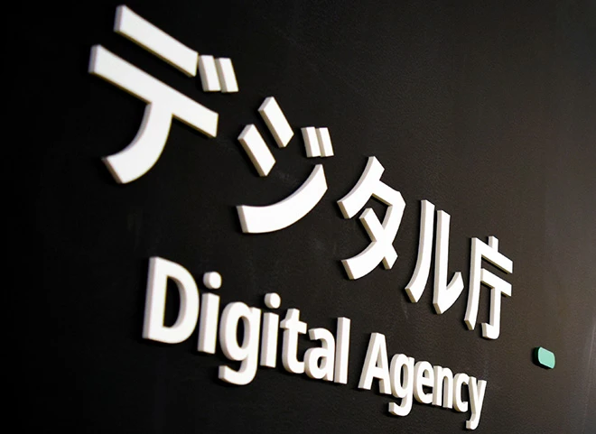

Asia: Singapore & Japan

Slide 20

United States of America
The Business Payments Coalition (supported by the US Federal Reserve) has been looking at:
How the US payments network can be modernised. (ISO22002)
How eInvoicing can be operationalised in the US market by 2023.
  eInvoicing Exchange Framework (similarities with Peppol)
  Market Pilot: Running now through to the end of 2022.
How E-remittance can close the loop between eInvoicing and Payments.

Slide 21
How You Can Get Involved in A-NZ

Slide 22
A-NZ Working Groups & Opportunities
General:
A-NZ Peppol All Stakeholders Working Group and Focus Groups
Sector Specific:
Service Provider Forum
DSPANZ A-NZ Service Provider Community Meeting
Government
Large business

Slide 23
eInvoicing Members

Slide 24
Questions?

Slide 25


Thank You for Joining Us!
This session has been recorded and will be made available alongside the slide on the webinar event page.
For more information:
hello@dspanz.org
www.dspanz.org

