Slide 1
VOICE BIOMETRIC IDENTITY VERIFICATION The New Zealand Experience

Slide 2
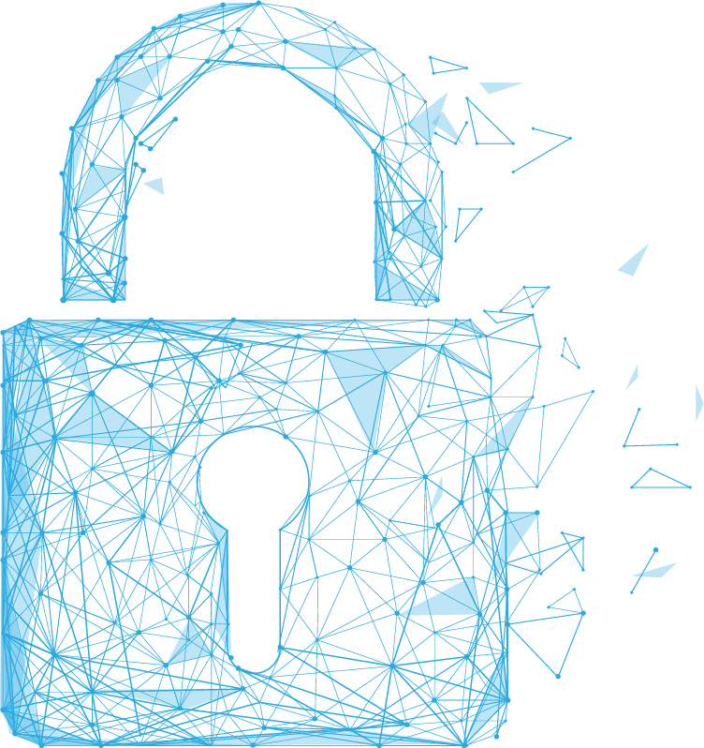
TABLE OF CONTENTS
How voice biometrics helps organizations verify identity
How voice biometrics helps organizations to comply with regulations
Lessons learned from the New Zealand case study
Future uses of voice biometrics

Slide 3
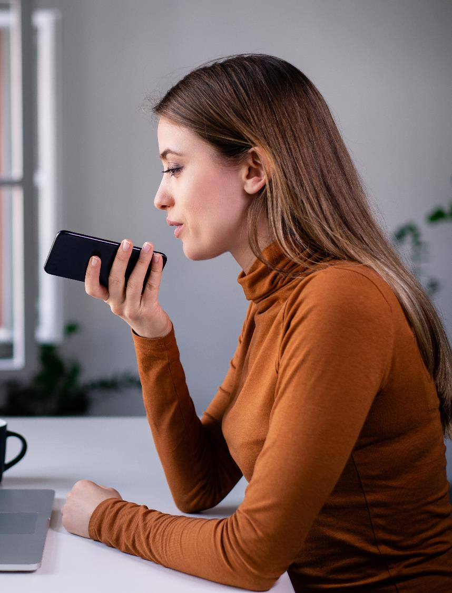
“YOUR VOICE IS UNIQUE TO YOU, AND YOU ONLY.”
Voice biometrics technology is more accurate than humans in distinguishing different voices.
Voice biometrics can crossmatch with an accuracy rate of more than 10,000:1.

Slide 4
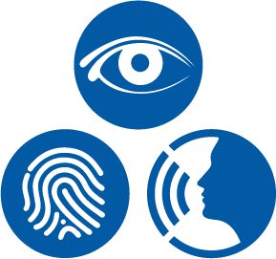
AGAINST OTHER PRINTS
Fingerprints and faceprints are stored locally in the device it was enrolled in - they are only as secure as a four/six-digit PIN
Multiple fingerprints and faceprints from different people enrolled in the same device means they can verify identity or transact online on behalf of the original user
Voiceprints are encrypted and stored behind the firewall and is device-independent

Slide 5
PROBLEMS ADDRESSED
PINs, passwords and security questions are inconvenient and insecure
Passwords can be complex and easily forgotten
Password resets often use OTPs which are tied to a device so fraudsters with possession of the device can reset passwords
It only verifies that person knows the right information and has possession of the device and not that the person is the rightful user.

Slide 6
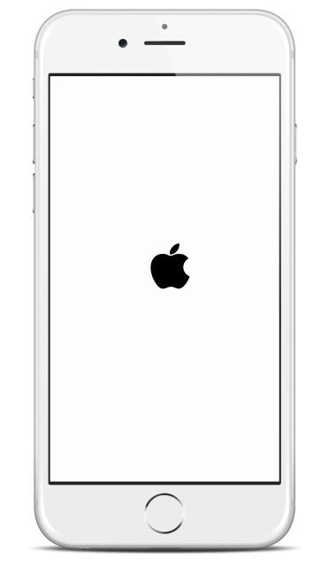
BANKING APP DEMO
TRANSFER & PAY
TRANSFER & PAY
LOGOUT
MY ACCOUNTS
PAYMENT CONFIRMATION
FROM ACCOUNT
Good Morning
Using voice biometrics for risk-based transaction in a banking app.
User is asked to say the one-time code
Voice sample is encrypted and posted behind firewall
Two checks are made: if the code was spoken correctly and if it matched the voice of the authorized person
Non-repudiable digital signature is created, and the transaction is completed if the two checks pass
Please confirm if all the details are correct.
JENNIFER
Personal Account #5543
658-255 78-586-5543
Available balance
Current balance
Amount
$1000.00
From
Jennifer
$3245.10
Personal Account #5543
658-255 78-586-5543
Available balance
Current balance
$3245.10
To
Jake
TO
Search
New
Savings Account #5587
658-255 78-586-5587
Available balance
Current balance
$3245.10
When
Today
$3245.10
Processing payment
$200.50
JAKE
BSB 586-554
Account number 58-425-3625
Description
$7355.60
Savings Account #5587
658-255 78-586-5587
Available balance
Current balance
Transfer
Pay anyone
Pay bills
Mobile
$200.50
An incorrect BSB or Account Number may result in your money being paid to the wrong person and you may not get your money back.
Payments made before 6 pm AEST/ AEDT should be received by bank accounts within 1 to 2 business days.
1000
AUTHORIZE PAYMENT
$7355.60
Amount ($)
Description for payee (optional)
Please touch the microphone and say
Total credit balance $15,940.50
2493 2493
Pay when
Today
My accounts
Transfer & pay
My cards
More
Payment confirmed
Next
Pay now

Slide 7
TELEPHONY IVR DEMO
IVR journey starts
Trusted CLID check
Phone number check
Voiceprint check
Once verified, caller is sent to agent with their details shown on agent control panel.

Slide 8
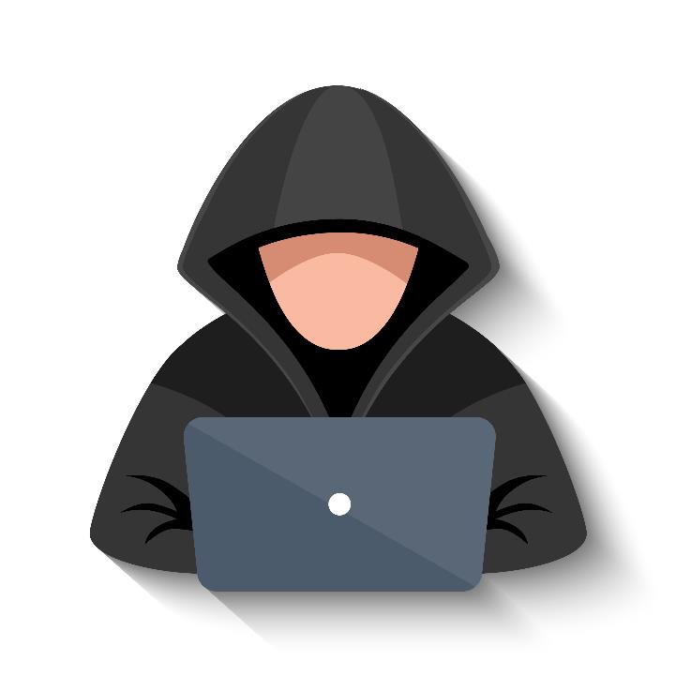
THWARTING SPOOF ATTACKS
Fraudsters may attempt to defraud an organization via synthetic voice or recorded playback attacks
Methods to thwart fraud attacks
Random challenge
Continuous passive authentication

Slide 9
BENEFITS OF VOICE BIOMETRICS
Complete risk transactions without post-call secondary processes to authorise transaction thanks to non-repudiable digital signature
Increased efficiency by eliminating manual verification processes such as email verification links and OTPs
Increased data privacy protection as exposing confidential information is not required
Reduce fraud losses and minimize reputational damage caused by account takeovers, identity theft and other fraud
Real-time fraud detection, allowing organizations to detect and flag potential fraud before it is too late

Slide 10
NEW ZEALAND GOVERNMENT Adoption of Voice Biometrics

Slide 11
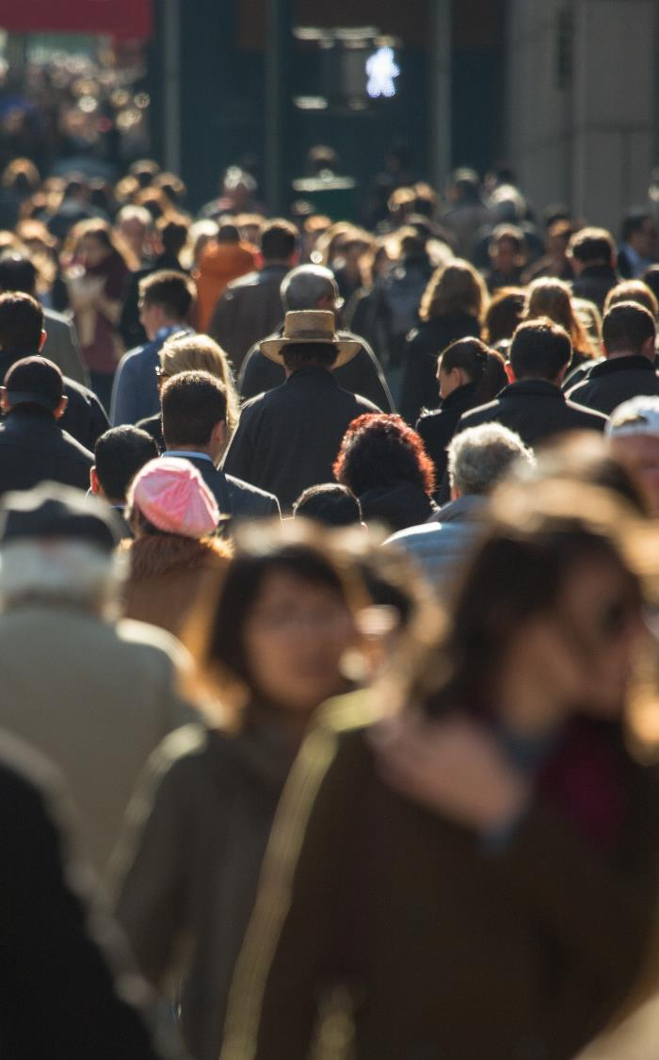
INTRODUCTION
Over 5 million citizens in New Zealand
Inland Revenue Department (IRD) and Ministry of Social Development (MSD) have been using Auraya’s voice biometric technology for identity verification for over a decade
Bank of New Zealand (BNZ) implemented Auraya’s voice biometric technology over 8 years ago and have successfully enrolled over 70% of its telephone banking customers
Others have followed suit with virtually all New Zealand departments using voice biometrics for identity verification and other banks and credit unions like ANZ have joined BNZ

Slide 12
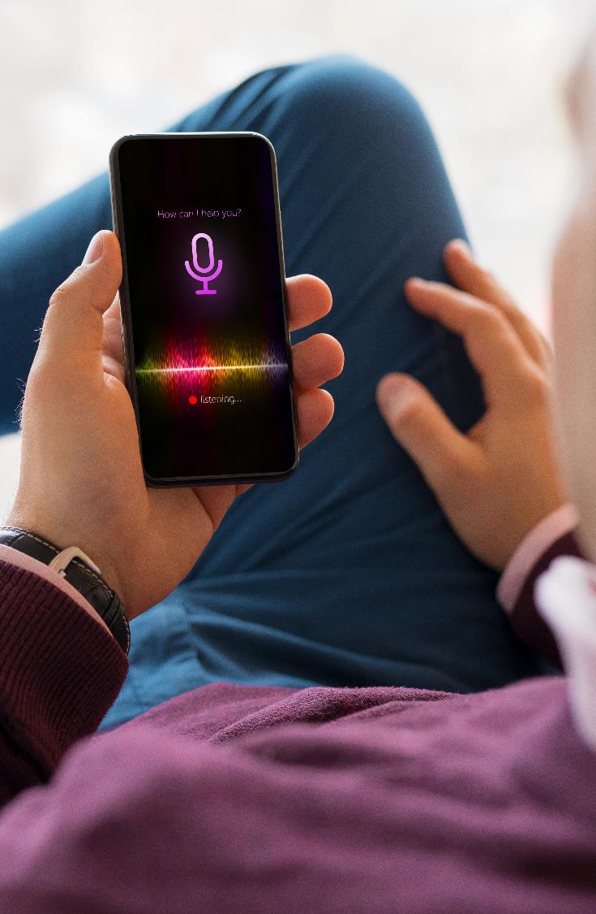
APPROACH TO ENROLMENT
Deliver messages to customers showcasing the benefits of voice biometrics such as improved security and a better and quicker service once enrolled
Some enrolment options
Enrolling in the IVR
During face-to-face interactions when applying for new accounts/government service
Via websites or mobile applications

Slide 13
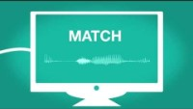
IRD VOICE ID

Slide 14
Voice Biometric Global Adoption
~75% of the New Zealand adult population have registered their voiceprints ~90% of MSD clients are verified prior to talking with an agent and > 70% of regular callers to BNZ use voice biometrics to verify their identity
~35% of the United Kingdom population have registered their voiceprints
HMRC, Barclays, Lloyds, HSBC similar trend in Europe
~35% of the Australian adult population have registered their voiceprints with ATO and Centrelink with voice Bio being used by banks and other financial services organisations and health providers. Telcos are now exploring options for efficiency and CX gains
~ 25% of North Americans have registered their voice prints and use them to access services (USA and CAN) although voice bots and cloud service delivery of voice biometrics is accelerating take up in the SME market with mid sized banks and health services driving uptake to improve efficiency, security and privacy
Asia Middle East and Africa are at an earlier stage of adoption however Africa is increasing uptake in Telcos where phones are used as digital wallets and security of device is driving demand

Slide 15
FUTURE TRENDS
Government agencies and private organisations will provide access to voice prints that are “certified” as being genuine prints of verified individuals to make it easier for citizens and customers to prove their identity status when opening new accounts or requesting access to services
Voice biometrics will be more widely used by security agencies to identify POI’s in real time and historical conversations
Voice trait analysis will become a powerful tool that can allow organizations to better understand and service clients by knowing their sentiment, gender, age and other voice discernable traits

Slide 16
CONTACT Paul Magee President paul.magee@aurayasystems.com
END

