Slide 1



“Anatomy of a Cyber Attack”
with Forensic IT
All attendees will be on mute for the duration of the webinar.
Throughout the webinar, please ask questions using the chat function.
The recording and slides for this webinar will be made available on our website.
Enjoy the webinar!
For more information:
hello@dspanz.org
www.dspanz.org

Slide 2
Acknowledgement
of Country
Notes:
Welcome and Acknowledgement of Country (Australia)
In the Spirit of Reconciliation, I would like acknowledge the Traditional Owners and Custodians of Australia and their ongoing connections to the lands, waters and communities.
I would also like to pay my respects to Elders past, present and emerging.

Slide 3

Belinda Stewart
DSPANZ Director & GNGB Director
Leveraging a wealth of leadership experience in compliance and data security, specialising in scoping, project management, consultation, and customised solutions. Bringing a unique perspective to the optimisation of Payroll, Time & Attendance, and HR processes. Recognised for the ability to devise innovative solutions, driving efficiency and ensuring compliance in business operations.

Slide 4

Charles Gillman
CISO - SuperChoice & DSPANZ Security Committee Co-Chair
With over two decades of expertise in Information Security, specialising in financial services. Led security teams at major institutions and held CISO roles in diverse settings, offering a comprehensive perspective from a background as a penetration tester. Provides practical solutions for current and emerging cybersecurity threats.

Slide 5

Jordan Hunt
Director of Cyber & Incident Response - Forensic IT
Drawing on extensive expertise in cyber incident response and forensic data analysis, Jordan is proficient in threat detection, digital forensics, and mobile device investigations. He brings a distinctive approach to cybersecurity challenges, adept at managing intricate cyber incidents and formulating effective strategies. Celebrated for his capability to improve cybersecurity defenses and establish resilient incident response frameworks.

Slide 6
“Anatomy of a Cyber Attack”
Jordan Hunt

Slide 7
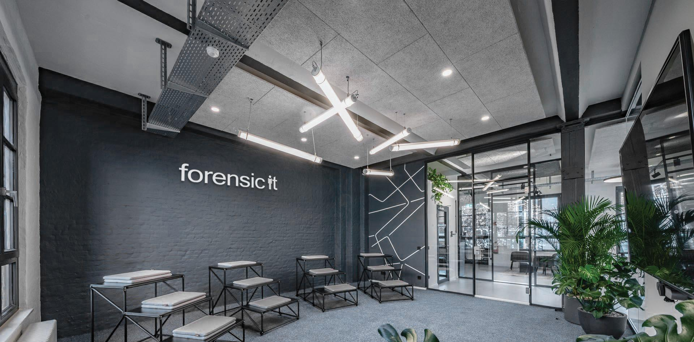
^{//_Anatomy of a Cyber Attack}

Slide 8

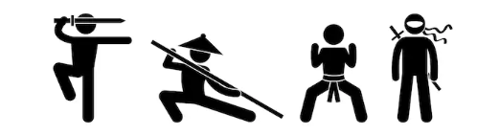




//_What’s the difference
IT Security
Cyber Security
Lockheed Martin – Cyber Kill Chain.

Slide 9
//_What’s the difference
Risk Management​
Asset, Change, Patch / Vulnerability & Configuration Management​
Cybersecurity Program Management​
Information Security Policies
Staff doing their part in keeping applications and operating systems up to date.
Threat Management​
Situational Awareness​
Event and Incident Response, Continuity of Operations​
Take note of communications from Cyber Security advisors
Know, how and when to report an issue.
IT Security
Cyber Security
Risk = threat x Vulnerability +/- Controls
Risk = Threat x Vulnerability +/- Action

Slide 10
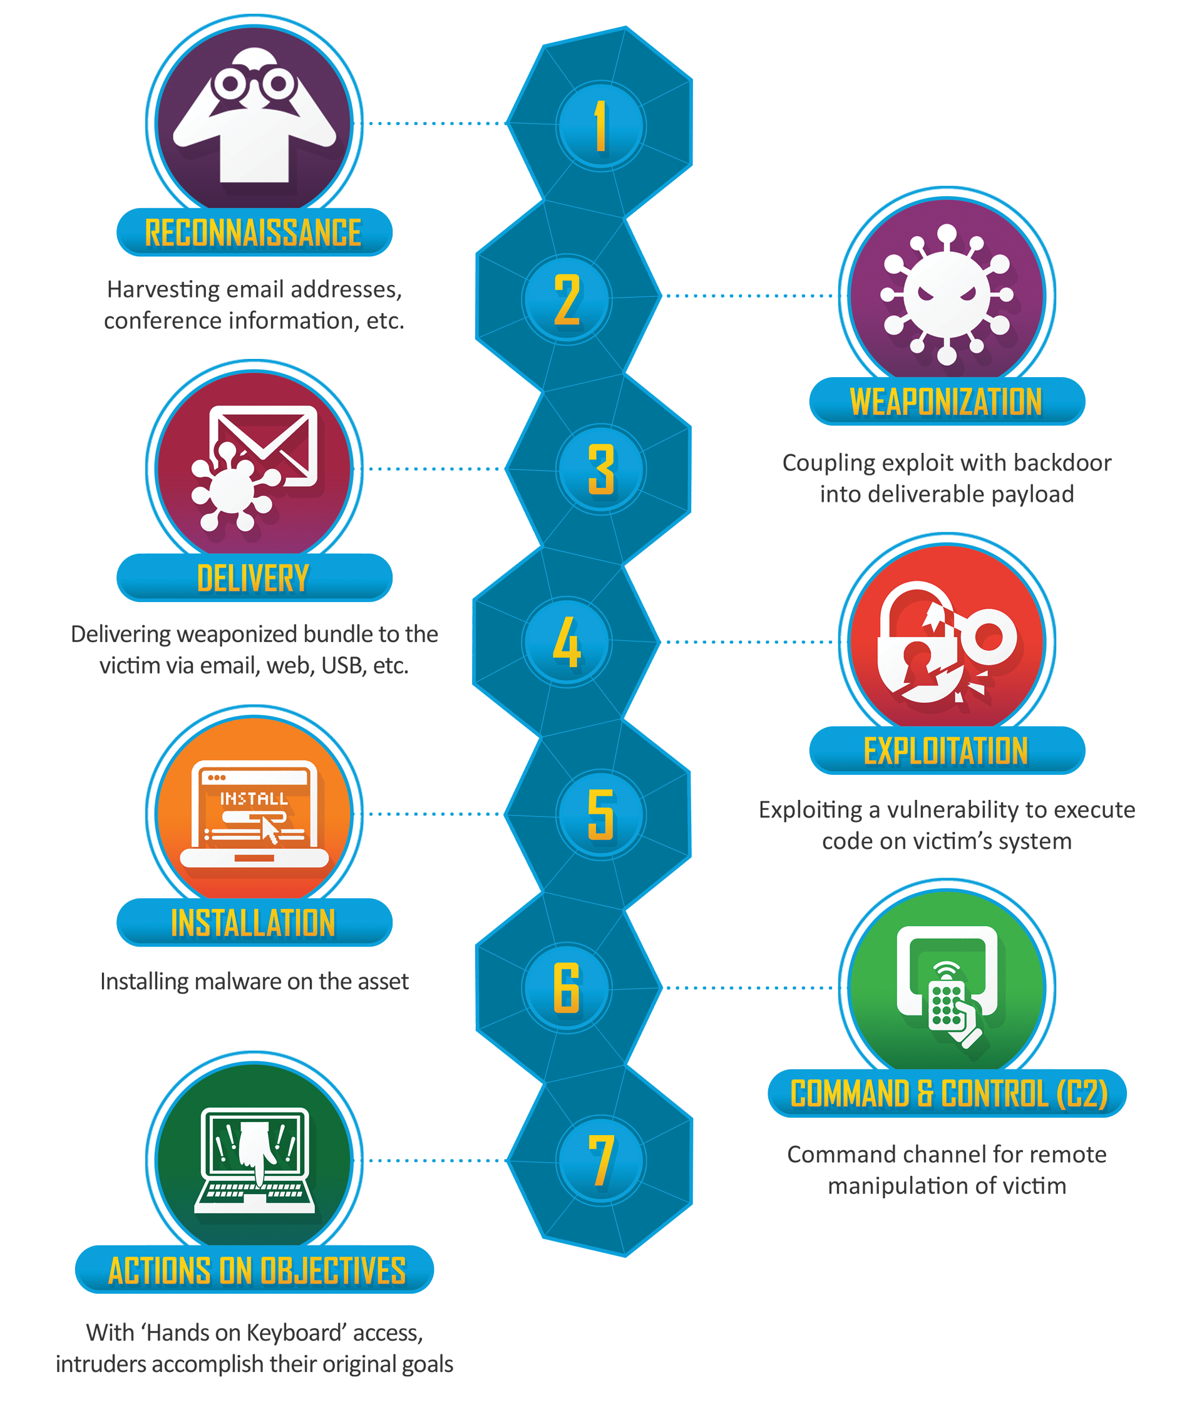
//_Some Context
Cyber Kill Chain
Cyber attacks don’t materializese out of thin air.
There is always a motive behind threat actors, and a process they MUST follow to achieve their objectives.
Lockheed Martin – Cyber Kill Chain.

Slide 11
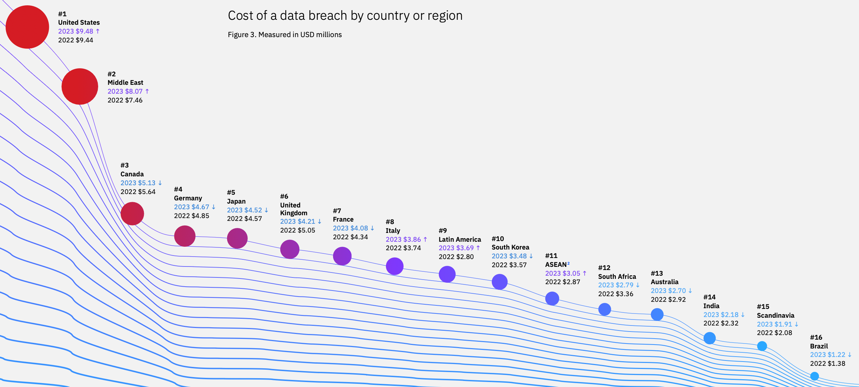
//_Some Context
The 2022/2023 AEP of 7.40% represents a 2.15% increase in the likelihood of a cyber incident impacting Australian organisations over the 2021/2022 figure of 5.25%.
Average cost to remediate cyber incident
*
IBM Cost of a Data Breach Report 2023
* Average cost is $2,110,164 AUD when outliers US and UAE removed.

Slide 12
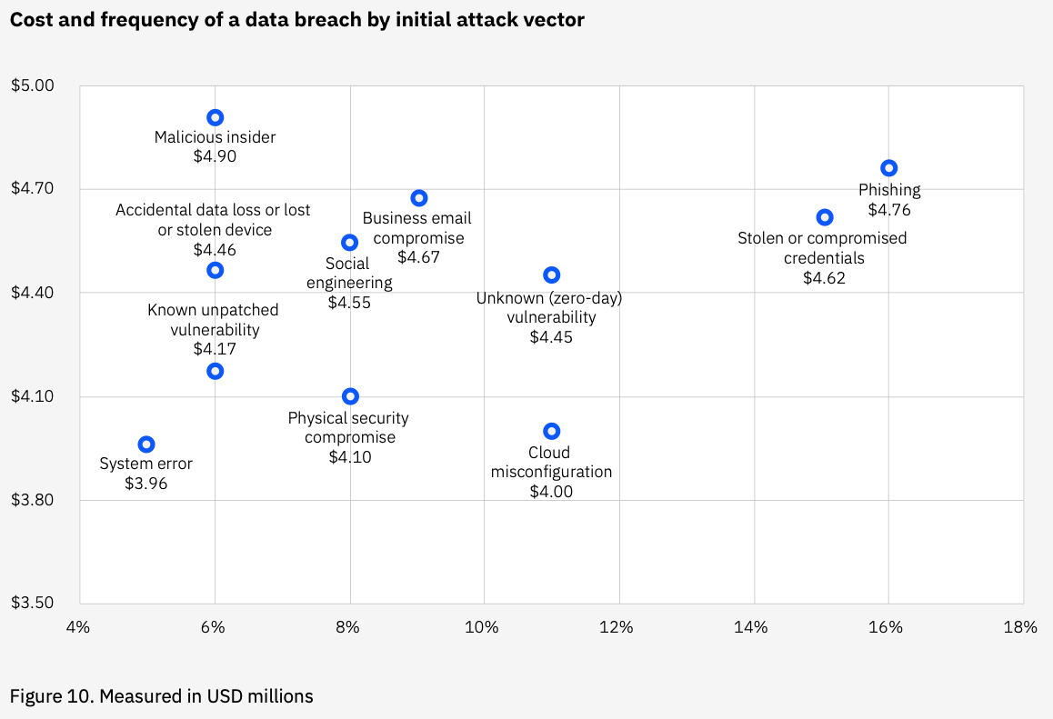
//_Some Context
Average cost to remediate cyber incident
% of cyber attacks by initial attack vector
IBM Cost of a Data Breach Report 2023

Slide 13
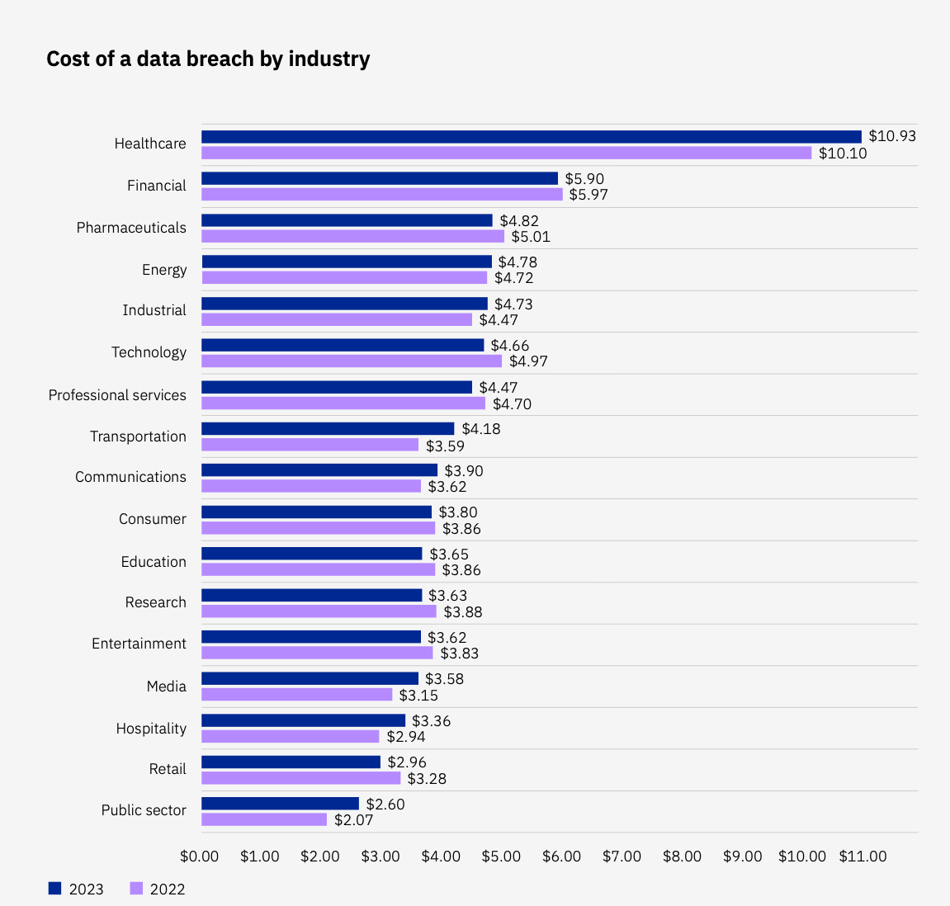
//_ Industry Impact by Cost
IBM Cost of a Data Breach Report 2023

Slide 14
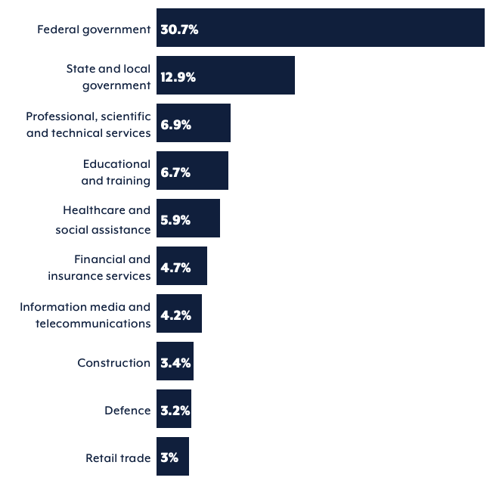
//_ Incident by Sector
Breaches in stricter regulatory environments tended to see more costs accrue in later years following the breach.
Top 10 industry sector cyber security incidents to which the ACSC responded in financial year 2022–23.
Note: The reporting frequency of government agencies is in part due to their obligations to report significant cyber security incidents to the ACSC, and may not necessarily reflect a greater susceptibility to cyber security incidents. https://www.cyber.gov.au/sites/default/files/2023-11/asd-cyber-threat-report-2023.pdfq

Slide 15
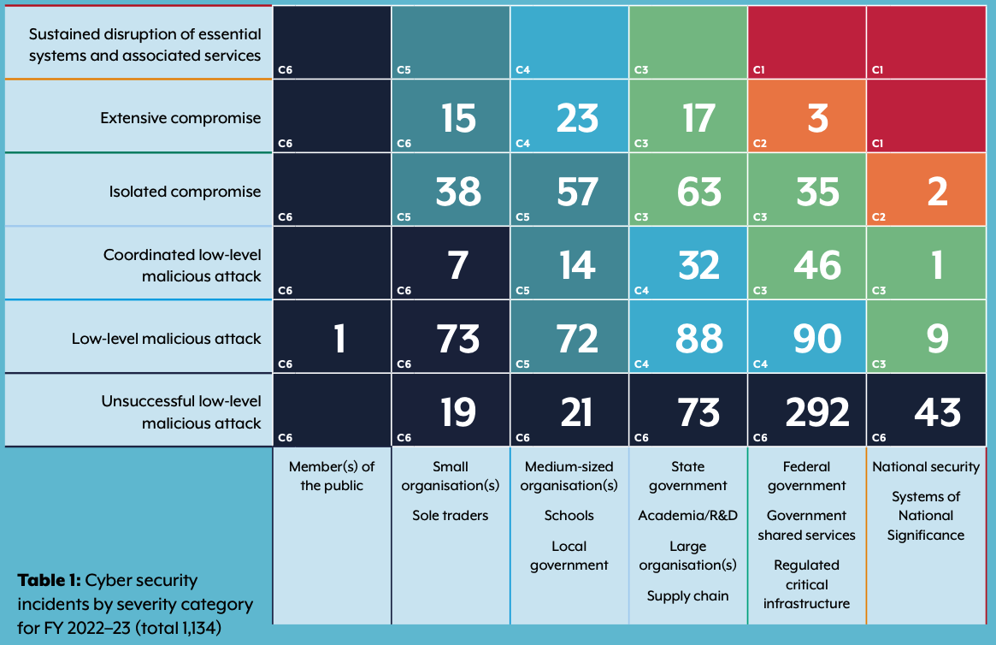
//_ Incident Severity Category
Breaches in stricter regulatory environments tended to see more costs accrue in later years following the breach.
ASCS Cyber security incidents by incident category for financial year 2022–23

Slide 16
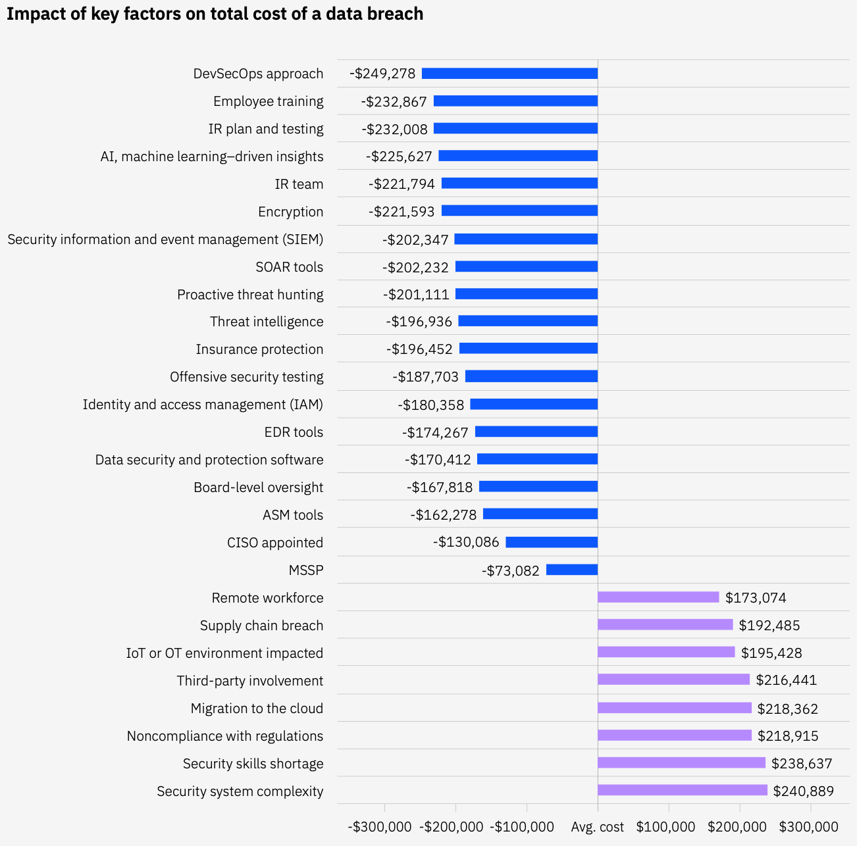
//_Factors to Reduce the Cost
IBM Cost of a Data Breach Report 2023

Slide 17
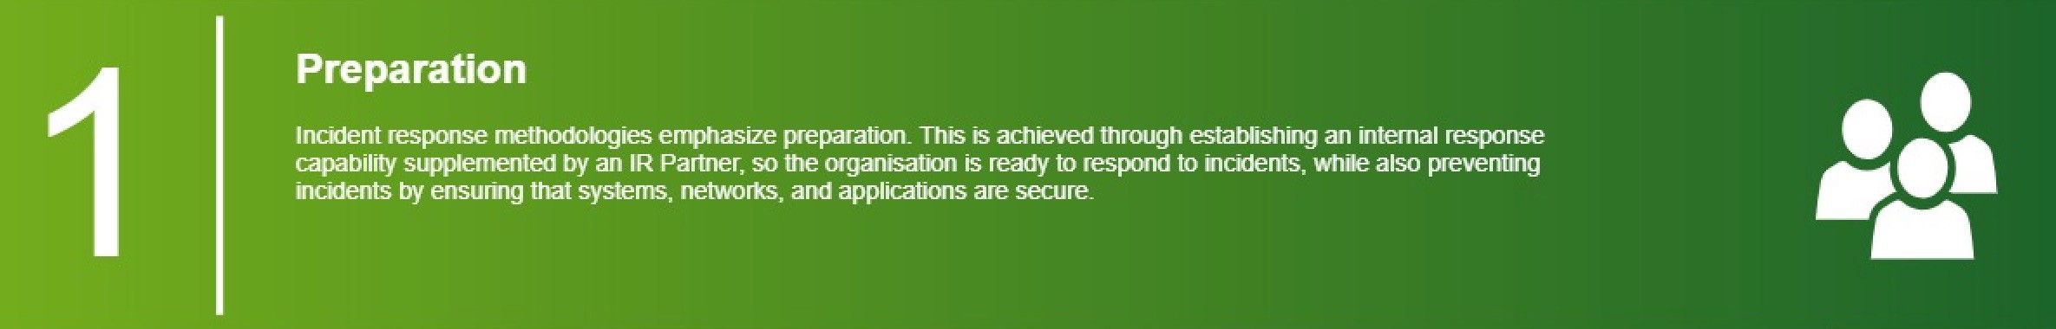
//_Cyber Response Incident Phases

Slide 18
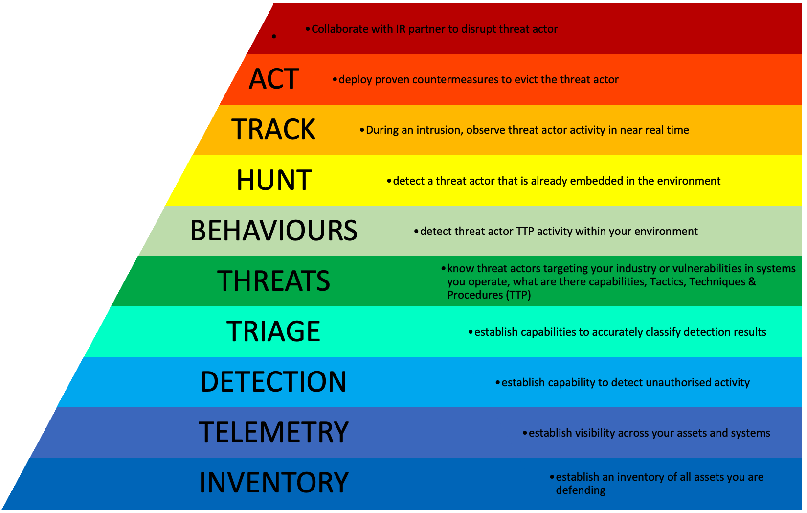
//_Preparation
Beginning with a solid inventory of all assets within the environment, understanding the systems they support and where they fit within the upstream or downstream supply chain of the business. Your organisation can then establish Telemetry and Detection capabilities to increase overall visibility of assets and systems.

Slide 19
//_Preparation
Profile Networks and Systems - Allows for measuring the characteristics of expected activity so that changes to your organisation’s environment can be more easily identified. Organisations should run file integrity checking software on hosts to derive checksums for critical files and monitoring network bandwidth usage to determine what the average and peak usage levels are on various days and times.
Understand Normal Behaviours – Your organisation should study networks, systems and applications to understand what their normal behaviour is, so that abnormal behaviour can be more readily recognised. No staff member will have a comprehensive knowledge of all behaviour throughout the organisation’s environment but should know which experts could fill in the gaps.

Slide 20
//_Preparation
Enable PowerShell Script Block Logging - PowerShell Module, Script Block, and Transaction logs, can be enabled via group policy. The default log size should also be increased to capture appropriate log time frames.
Log Retention Processes - Information regarding a cyber security incident may be recorded in several places, such as firewall and application logs. Creating and implementing a log retention process that specifies how long log data should be maintained will be extremely helpful in analysis because older log entries may show reconnaissance activity or previous instances of similar attacks. The length of time to maintain log data will depend on several factors, including your organisation’s data retention policies and the volume of data.

Slide 21
//_Preparation
Keep All Host Clocks Synchronised - Protocols such as the Network Time Protocol (NTP) synchronise clocks among hosts. Event correlation will be more complicated if the devices reporting events have inconsistent clock settings. From an evidentiary standpoint, it is essential to have consistent timestamps in logs.
Maintain and Use a Knowledge Base of Information – Your organisation’s ICT knowledge base should include information that the IMT need for referencing quickly during cyber security incident analysis. A simple approach to system documentation will be most effective. Text documents, spreadsheets, and relatively simple databases provide effective, flexible and searchable mechanisms for sharing data among IMT members.

Slide 22
//_Preparation
Ensure Volume Shadow Copy Snapshots are enabled – All systems critical to the delivery of the organisation’s services should have Volume Shadow copy snapshots enabled, with the “scope snapshots” functionality disabled to ensure all critical data is protected. In addition to this, increasing the reserved size for snapshots and the frequency (using scheduled tasks) should be considered for critical systems.
Increase NTFS Journal file size – The Microsoft Windows NT File System (NTFS) maintains multiple files that are critical to the successful investigation of cyber incidents. The $Logfile and $USNJRNL record file and folder metadata for each individual NTFS volume. The file size of these two NTFS artifacts can be increased to ensure the potential attack time window is retained .

Slide 23
//_Case Study
On Saturday the 9th of September 2023, Forensic IT were engaged by the client to investigate the potential compromise of their cloud infrastructure and systems. The client had identified that on the 4th of September 2023 between 10:49PM and 11:48PM (AEST) a total of 36 unauthorised cryptocurrency transactions consisting of a mix of Ethereum and Ethereum Tokens on Ethereum-compatible blockchains occurred from a web platform developed and operated by the client.
The unauthorised transactions collectively withdrew almost all available digital assets from one of the “hot” wallets supporting the web platform production environment. The total amount of the digital assets stolen was almost limited by the available funds within the wallet, except that the transaction service crashed just prior to that occurring.
The total amount of Ethereum / Ethereum Tokens stolen from the hot wallet at the time of the incident was estimated at approximately $62 Million AUD.

Slide 24
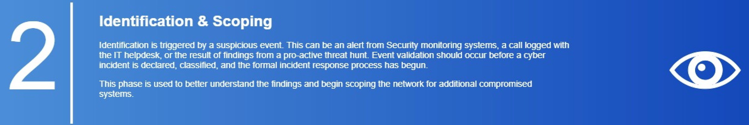
//_Cyber Response Incident Phases

Slide 25
//_Case Study
Initial access to the client's web platform / environment was obtained through a sophisticated social engineering campaign that has been identified and reported on by multiple cyber intelligence organisations. Over the previous few months 5 cyber incidents resulting in the theft of large sums of cryptocurrency have been attributed to the Lazarus Group (AKA Labyrinth Chollima, Hidden Cobra, APT37, APT38 or Jade Sleet), a hacking group with links to the North Korean Government (Democratic People's Republic of Korea). The cyber incident impacting the client was part of this Lazarus Group campaign.

Slide 26
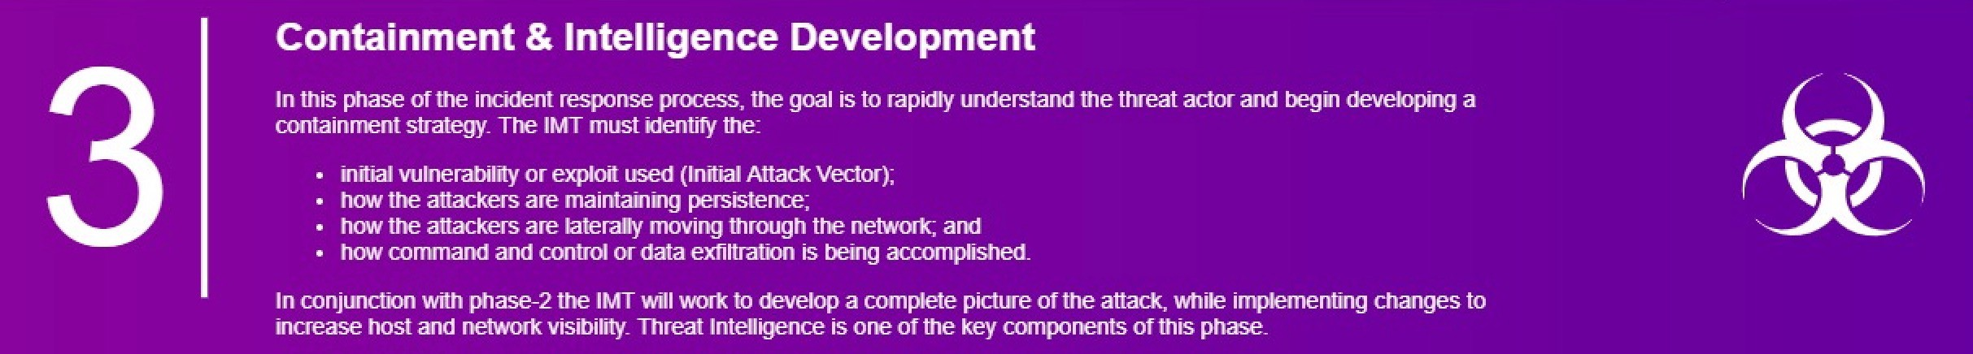
//_Cyber Response Incident Phases

Slide 27
//_Case Study
An internal developer (e.g. John Smith) confirmed he has been undergoing a recruitment process. The recruitment agency reached out initially to him via LinkedIn (and subsequently Telegram). As part of the interview process, John Smith has been tasked to download and work with a given GitHub repository and solve certain challenge as a test of his technical skillset.
John further confirmed he undertook the test task on his personal laptop, on which in the past he had used legitimate credentials to access various corporate / development environments and systems.
On noticing certain irregularities on his device, John conducted a full factory reset his laptop in the morning prior to crypto theft occurring.
It was confirmed that John had been part of a sophisticated social engineering campaign targeted at the organisation’s development team, where the threat actor were able to compromise John’s personal laptop to harvest his credentials (with AWS administrative rights) to carry out the subsequent attack.
Notes:
Having these key factors in place reduces the average cost of a data breach

Slide 28
//_Case Study
GitHub / Docker Hub Analysis
A preliminary review of GitHub logs confirmed the compromise and use of the John Smith account to access GitHub / Docker Hub with suspicious user agents recorded between 4 August 2023 14:29 and 2 September 2023 00:45:
Mozilla/5.0 (Windows NT 10.0; Win64; x64) AppleWebKit / 537.36 (KHTML, like Gecko) Chrome /116.0.0.0 Safari/ 537.36
Mozilla/5.0 (Windows NT 10.0; Win64; x64) AppleWebKit/537.36 (KHTML, like Gecko) Chrome/115.0.0.0 Safari/537.36
Through discussions with client staff and analysis of logs, it was identified that the compromised version of the docker image was created by the threat actor within the clients private Docker Hub account on 31 August 2023 and subsequently tagged as “production”, initiating the attack and theft of crypto currency.
Notes:
Having these key factors in place reduces the average cost of a data breach

Slide 29
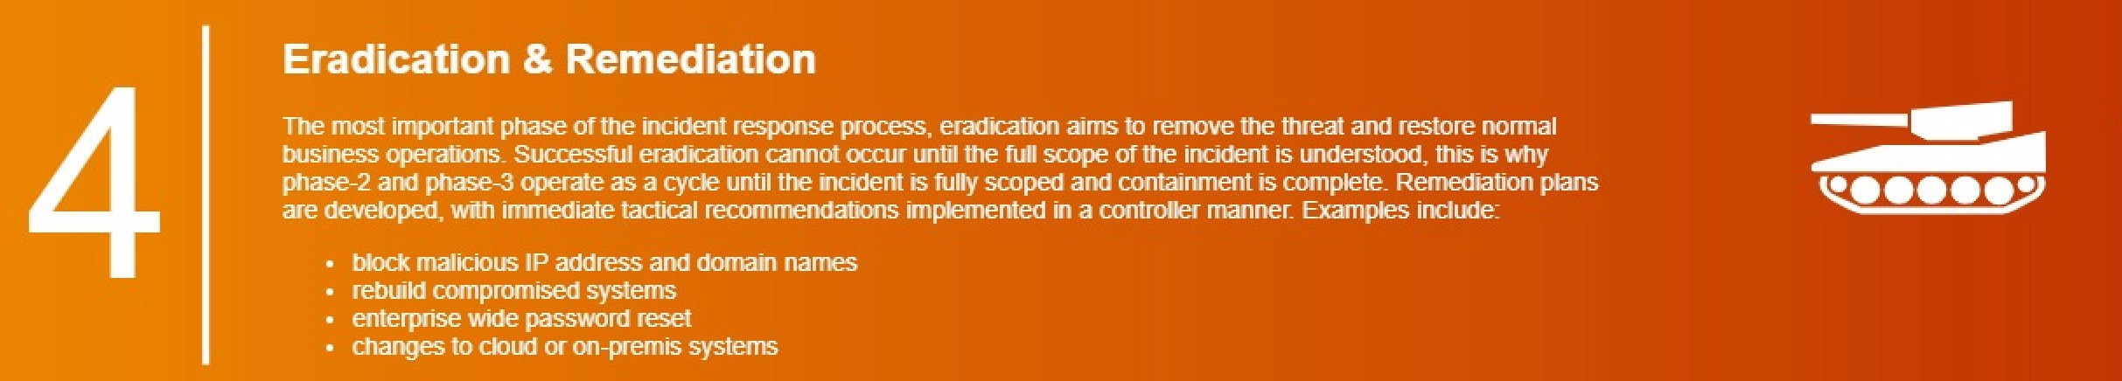
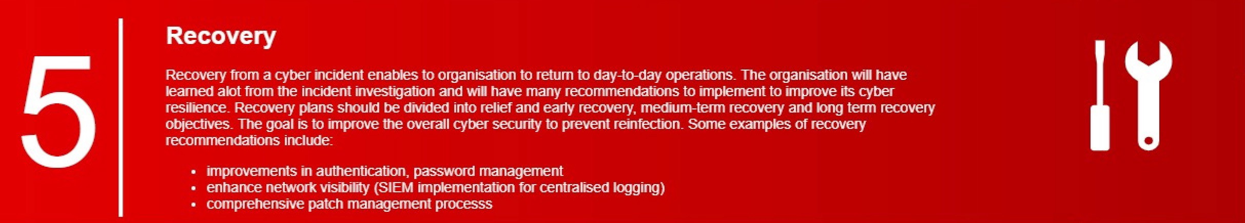
//_Cyber Response Incident Phases
Notes:
Having these key factors in place reduces the average cost of a data breach

Slide 30
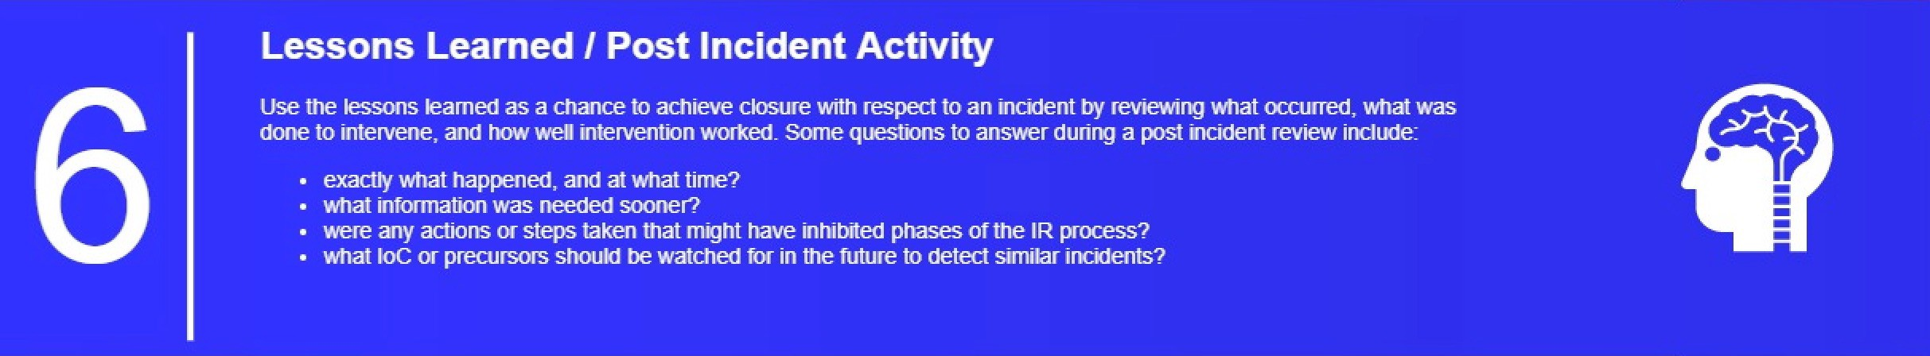
//_Cyber Response Incident Phases
Notes:
Having these key factors in place reduces the average cost of a data breach

Slide 31
//_Log Management & Retention
Since event logs can contribute to investigations following cyber security incidents,
they should ideally be retained for the life of a system, and potentially longer.
However, the minimum retention requirement for these records under the Public
Record Office Victoria (PROV) Common Administrative Functions Retention and
Disposal Authority (RDA) publication is seven years. The governing body will likely
change depend on the state in which your organization and clients are operating.
The following list of events can assist in monitoring the security posture of systems,
detecting malicious behaviour, and contributing to investigations following cyber
security incidents in the future.
For any system requiring authentication, successful logon, failed logon and logoff events are logged.
Notes:
Having these key factors in place reduces the average cost of a data breach

Slide 32
//_Log Management & Retention
The following events are logged for operating systems:
access to important data and processes
application crashes and any error messages
attempts to use special privileges
changes to accounts
changes to security policy
changes to system configurations
Domain Name System (DNS) and Hypertext Transfer Protocol requests
failed attempts to access data and system resources
service failures and restarts
system start-up and shutdown
transfer of data to external media
user or group management
use of special privileges.
Command line execution
Notes:
Having these key factors in place reduces the average cost of a data breach

Slide 33
//_Log Management & Retention
The following events are logged for web applications:
authenticated user access
attempted access that is denied
crashes and any error messages
search queries initiated by users.
user agents connecting
IP addresses and associated port of connection
access to sensitive information
Notes:
Having these key factors in place reduces the average cost of a data breach

Slide 34
//_Log Management & Retention
The following events are logged for databases:
access to particularly important information
addition of new users, especially privileged users
any query containing comments
any query containing multiple embedded queries
any query or database alerts or failures
attempts to elevate privileges
attempted access that is successful or unsuccessful
changes to the database structure
changes to user roles or database permissions
database administrator actions
database logons and logoffs
modifications to data
use of executable commands.
Notes:
Having these key factors in place reduces the average cost of a data breach

Slide 35
//_Change the
Context
You can reduce the risk of cyber attacks by:
Thinking before you act;
being aware of the Delivery methods;
play your role in keeping Systems up to date; and
maintaining good password hygiene.

Slide 36

Jordan Hunt – Principal Analyst, Cyber Incident Response
⁺⁶¹ ⁴³⁷ ⁹⁷⁹ ¹⁶³
^{Jordan.hunt@forensicit.com.au}
Thank you for listening
^{//_CONTACT}

Slide 37
Group Q&A

Slide 38
Thank you for joining us
The recording and slides for this webinar will be made available on DSPANZ website.
For more information:
hello@dspanz.org
www.dspanz.org

